Slide 1

Welcome to the Council of Graduate Departments of Psychology 2025 Annual Meeting

Slide 2

Meeting space wifi password
“utguest" and there's no password required for use.

Slide 3




The 2025 annual meeting theme
Managing and Prioritizing the many duties of chairs/HEADS: How to be the best Swiss army knife

Slide 4
Leadership
“My leadership experiences have underscored the importance of being proactive and working to create the future. We must ground our vision in concrete actions, big and small. Key is the need to focus on people—nothing can be done without mobilizing our communities. That requires being attentive to both head and heart as we manage crises. We must guide the intellectual and emotional journeys of our faculty, staff, and students as we navigate constant change.”

Slide 5
Toughest job in higher education: Chairs’ responsibilities
Angela Lumpkin & Stephanie J. Jones
The authors and their colleagues identified over 62 responsibilities in 7 categories Chairs are expected to complete.
Personnel management, effective internal and external communications, budget and resource management, instructional leadership, department climate and culture, departmental change and advancement, and department chair as faculty.
Develop communication, mentoring, negotiation, delegation, financial, managerial, and leadership skills and abilities, while identifying the need for gaining upper administrative support for expanded training and resources to better prepare them to complete not only the toughest, but one of the most important, jobs on campus.

Slide 6
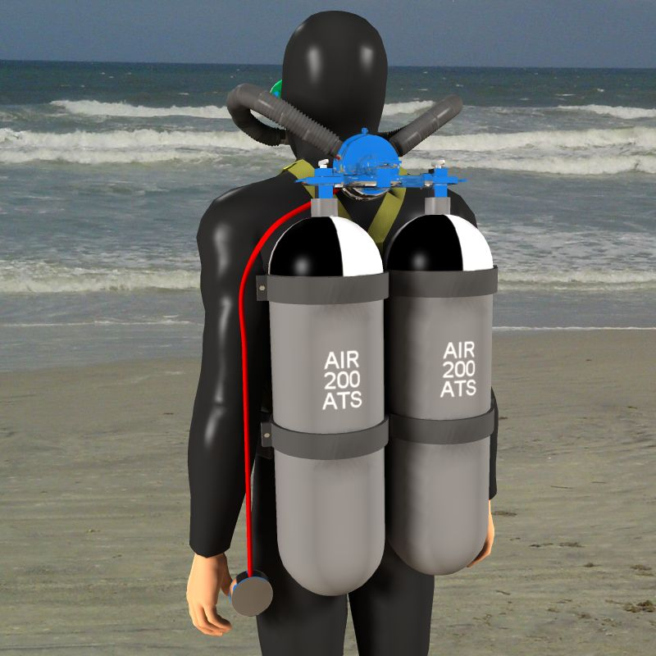

Under Water
Aqua Lungs
I’m OK (or at least I don’t see the shark behind me)

Slide 7



Drinking from a fire hose

Slide 8
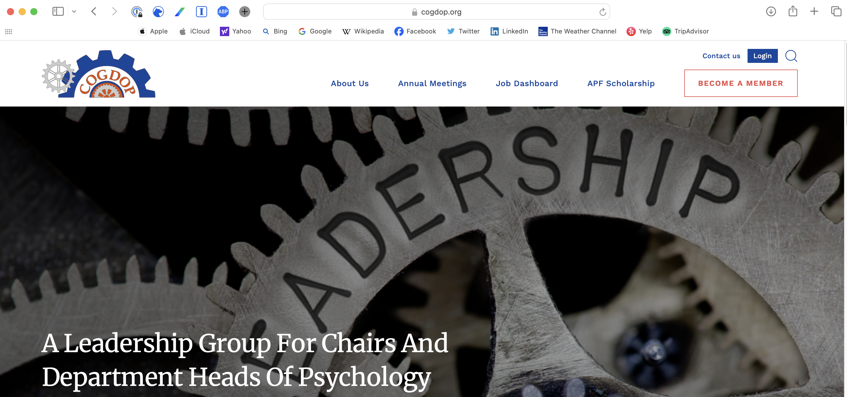

Slide 9
Board Members
Debi Bell
Brian Daly
Mike Dougherty
Jennifer Mangels
Sandra Morissette
Paula Shear
Jack Shelley-Tremblay
Jay Smart

Slide 10
A little bit about COGDOP
Members are the chairs and heads of a wide range of departments of psychology that have graduate programs
Established in 1967 to facilitate communication and collaboration between graduate programs in psychology (nearly 58 years old!)
Promotes excellence in graduate psychology education and training
Ensures that the field continues to evolve to meet the changing needs of society
Provides peer support and professional development for those in challenging chair and head roles

Slide 11
Program Highlights
Managing up (Art Markman)
Fostering an inclusive psychology pipeline (Nazish Salahuddin)
Feedback to strengthen your leadership (Jack Shelley-Tremblay)
Working with your Dean (Ann Huff Stevens)
Effective delegation (Brian Daly, Sandra Morissette)
SCOTUS, Affirmative action, DEI (Sandy McDonough)
Science policy updates (FABBS)
Planning during uncertainty (Mike Dougherty, Jay Smart)

Slide 12

A few items of information
Please reach out to those wearing ribbons that indicate they are new chairs!
CE credits
Structure/location of breakout sessions and lunch (on your own)
We hope you choose to sign up for group dinners for tonight and Saturday. Sign-up sheets are at the front desk. We cannot exceed 6-8 people at a table.
We are happy to coordinate dinners, but your meal will be at your own expense.
Please attend the business meeting for updates on COGDOP activities. We value and act on suggestions from our members.
Extra credit and glory if you help us recruit new members from your institution, or those close to you geographically.

Slide 13

We strive to provide a safe place to share experiences
As department chairs, we have limited forums for open discussion in the workplace
COGDOP provides unique place for conversations with others who understand your role and obligations
What happens at COGDOP stays at COGDOP!

Slide 14
Welcome
We are thrilled to have you here and look forward to a wonderful meeting
Let us know how we can be helpful
A special THANK YOU to David Schnyer, Chair of the Psychology Department at UT Austin – who served as a co-planner, and his team - Gina Pollard, and his student volunteers, Isabella and Armaan.

Slide 15
