Slide 1
The Supreme Court’s Harvard Decision and Executive Orders: The Impact on Higher Education

Slide 2
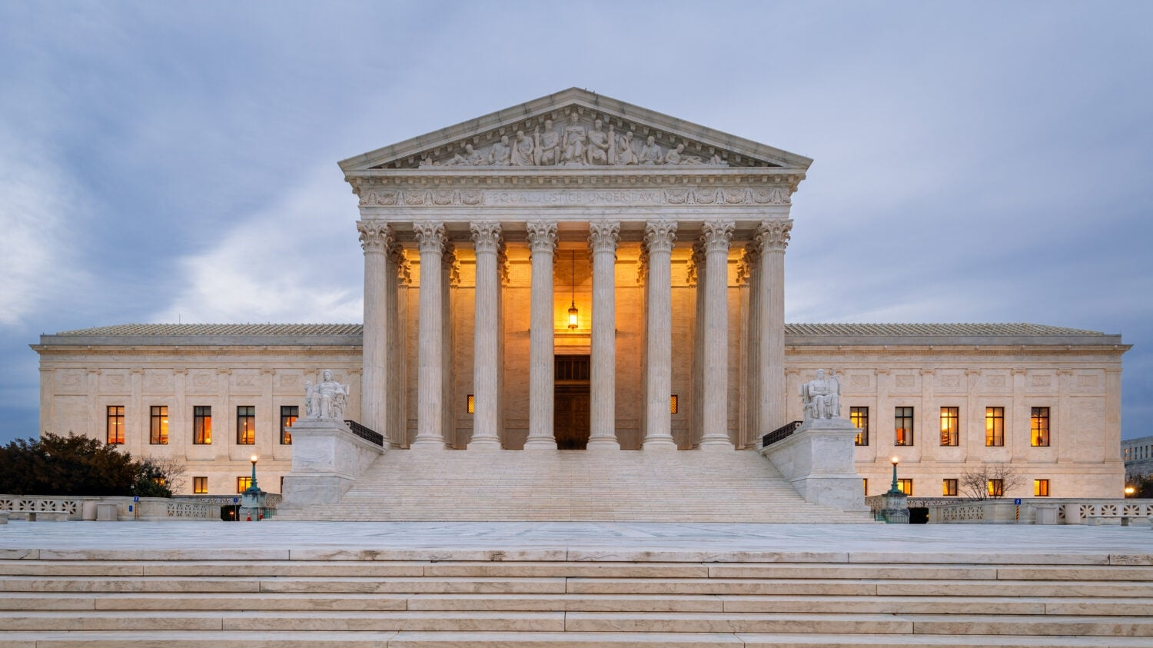
Starting with some background:
How did we get here?

Slide 3
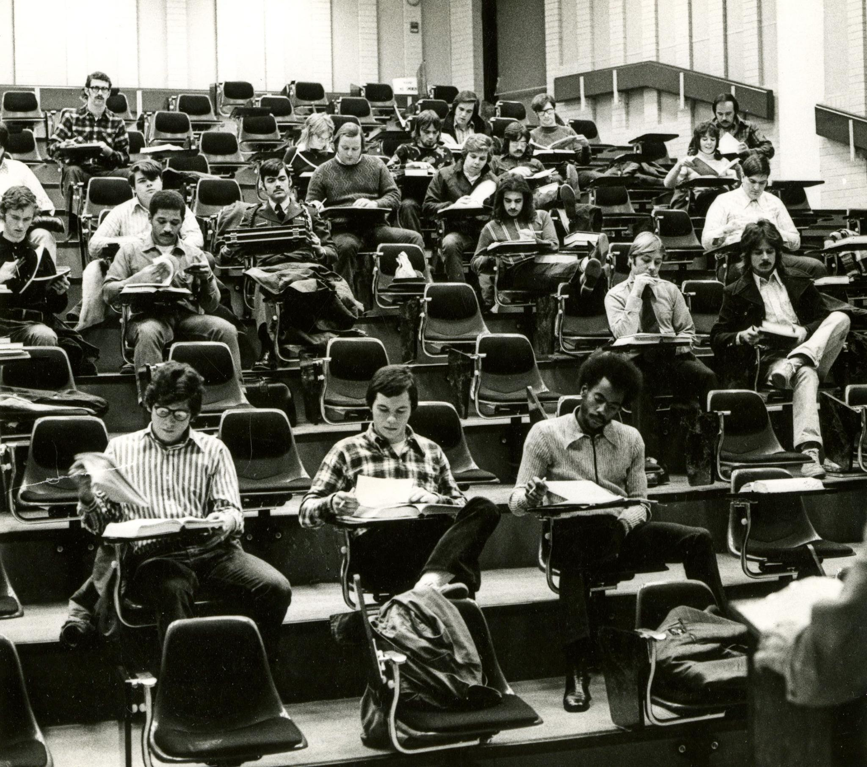
DeFunis v. Odegaard (1974)
Regents of the University of California v. Bakke (1978)
Grutter v. Bollinger (2003)
Gratz v. Bollinger (2003)
Fisher v. University of Texas (2016)

Slide 4
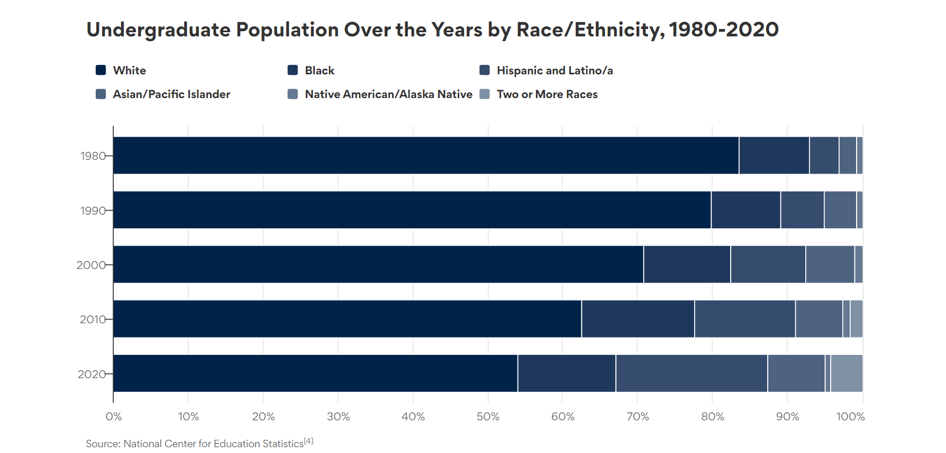

Slide 5
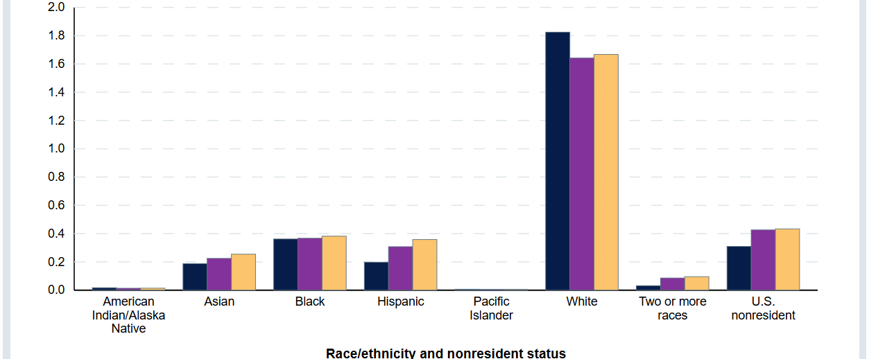

Slide 6



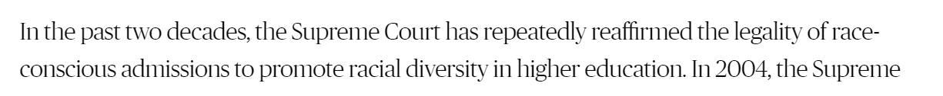
Add affirmative action map

Slide 7
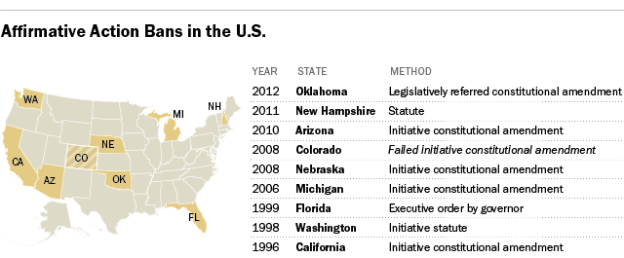

Slide 8
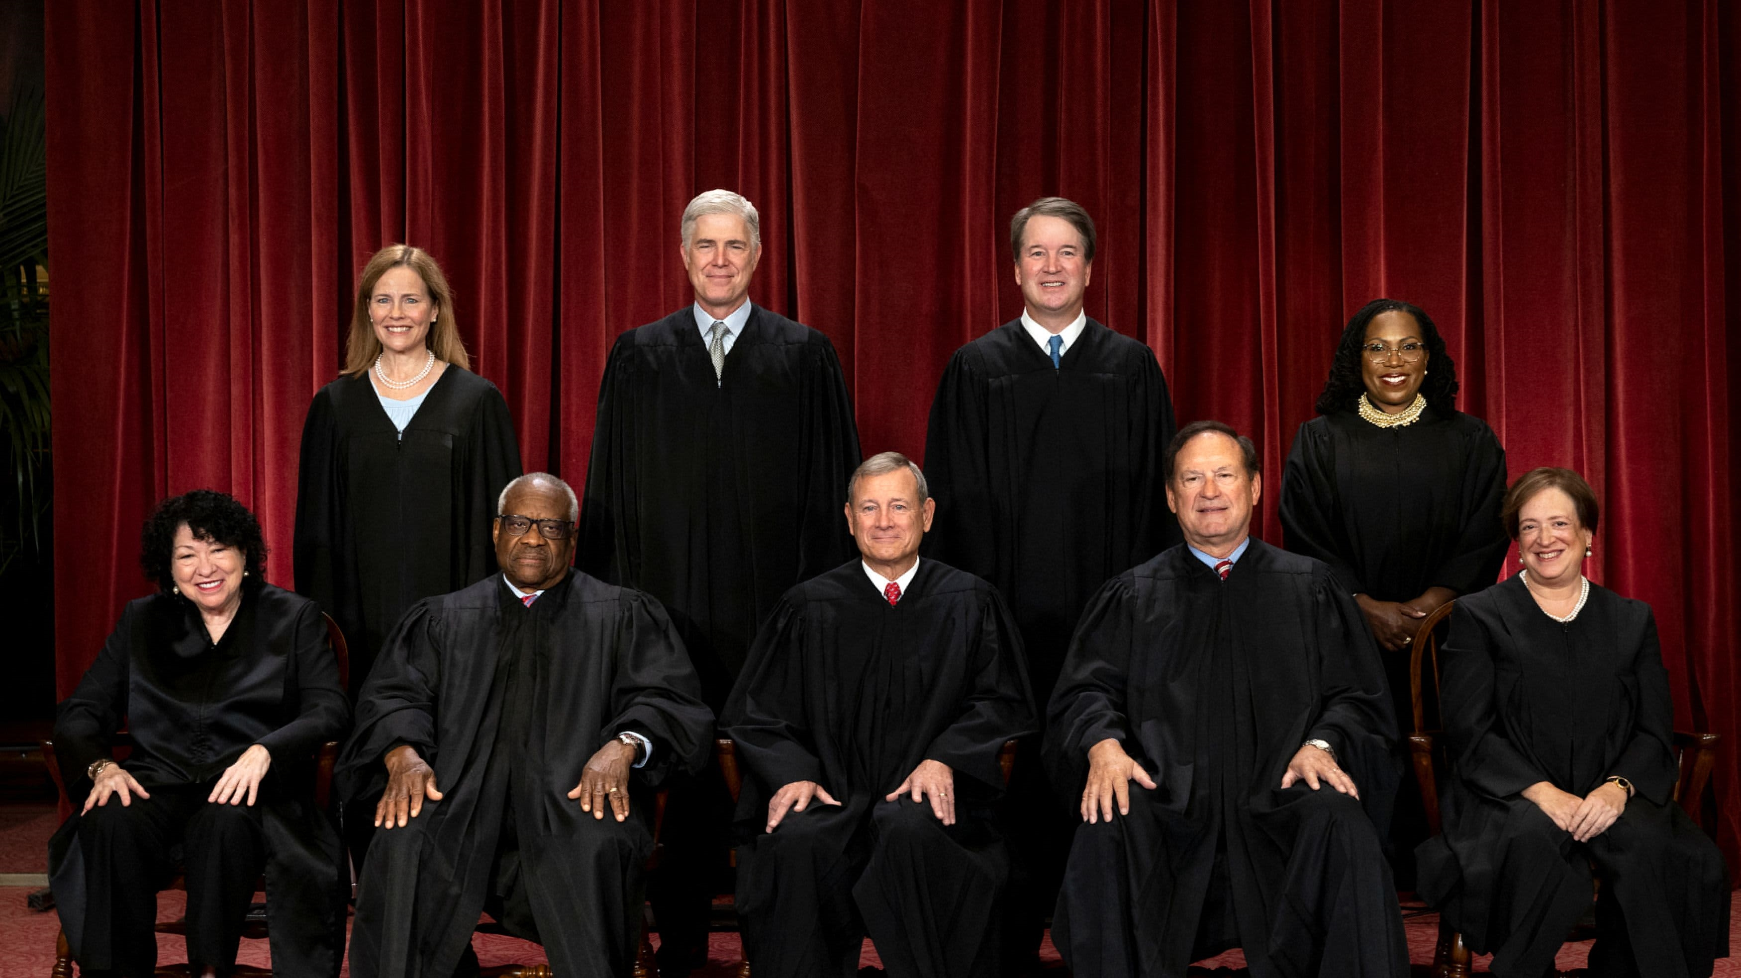
Then, a sea change for everyone:
What the Supreme Court said

Slide 9
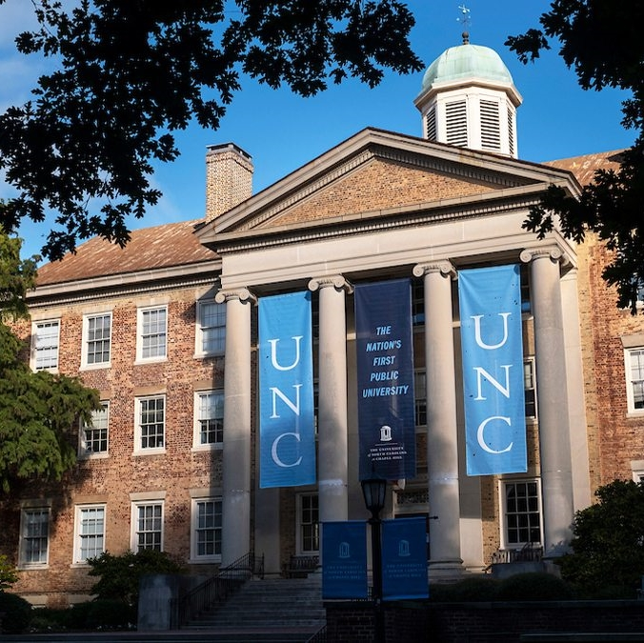
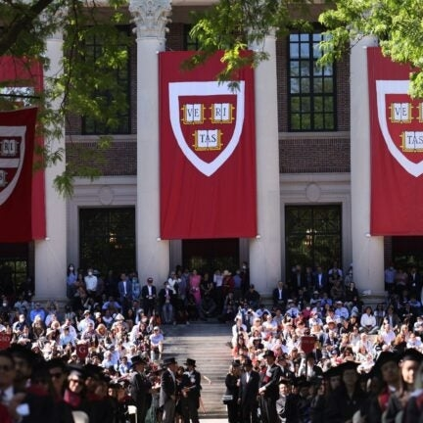
The case
Facts about UNC program
Facts about Harvard program
“The question presented is whether the admissions systems
used by Harvard College and UNC are lawful under the Equal Protection Clause of the Fourteenth Amendment.”

Slide 10
  “Harvard and UNC admissions programs cannot be reconciled with the guarantees of the Equal Protection Clause.”

Slide 11
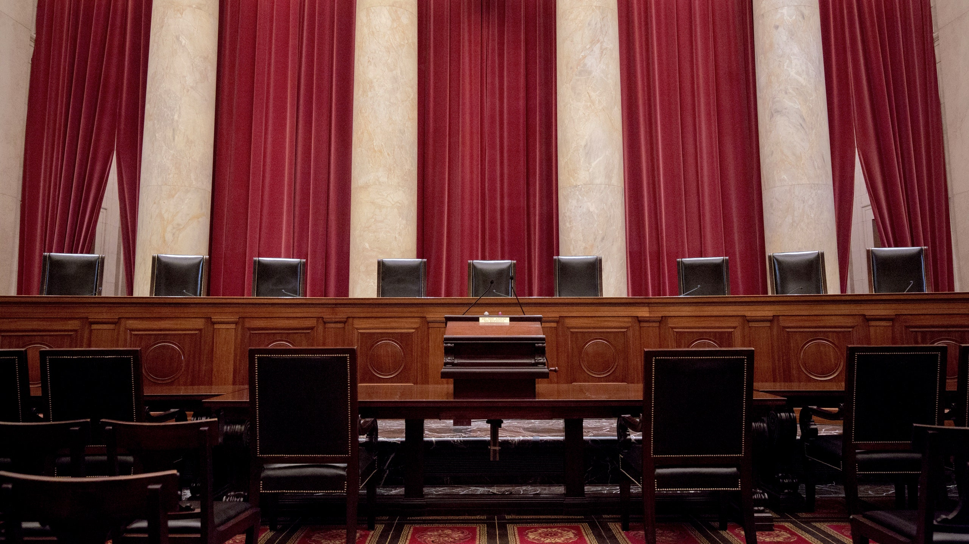
“nothing in this opinion should be construed as prohibiting universities from considering an applicant’s discussion of how race affected his or her life, be it through discrimination, inspiration, or otherwise.”

Slide 12
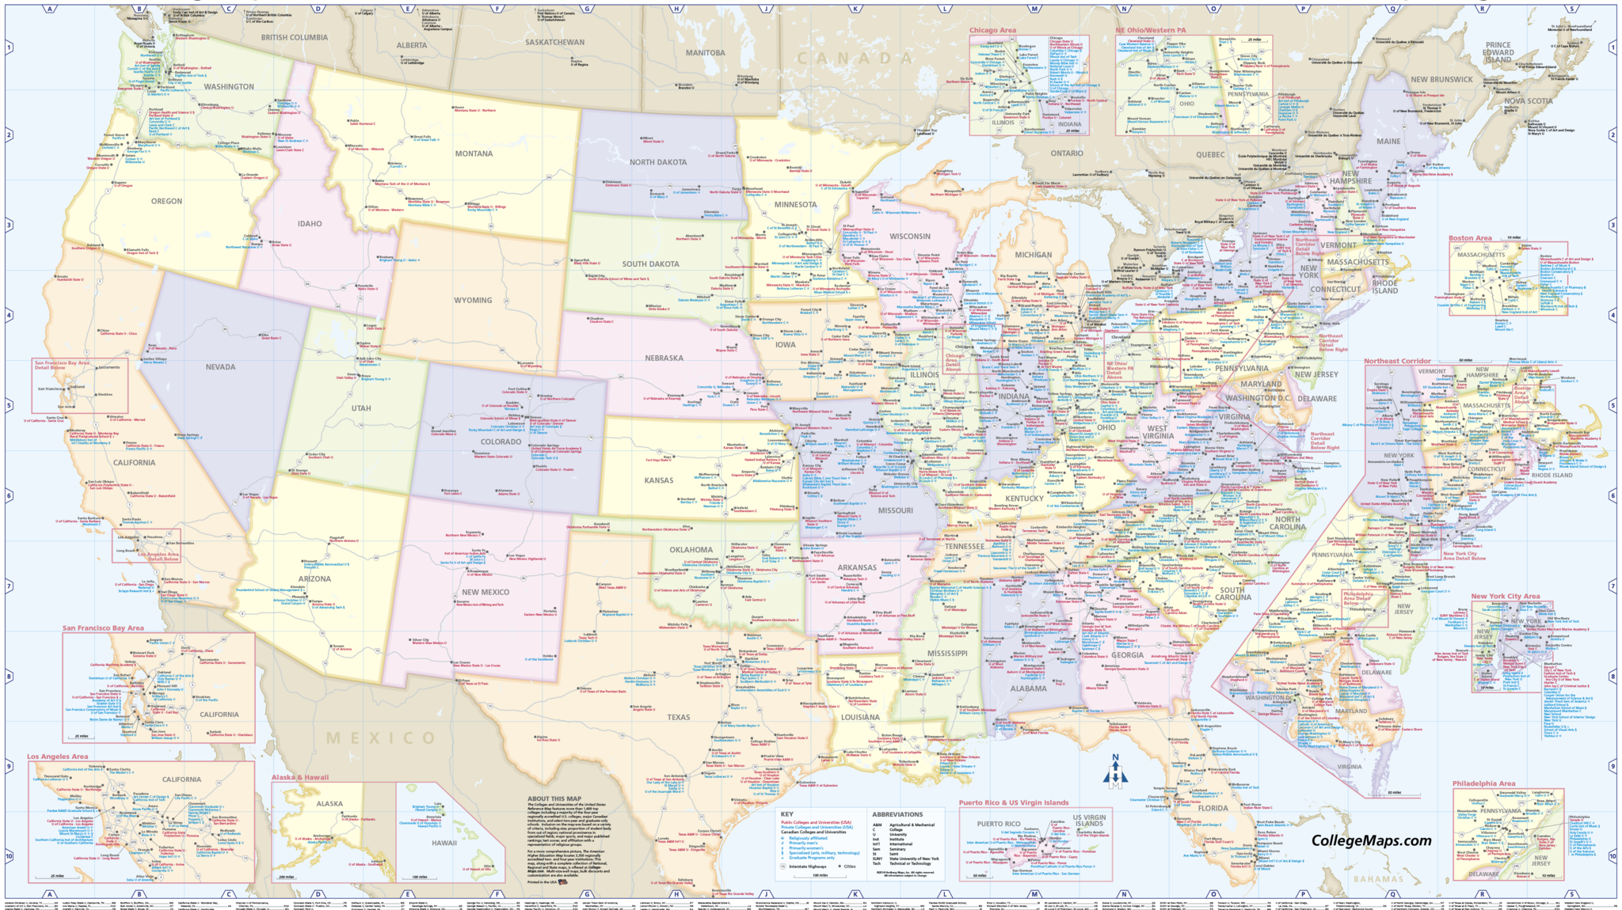
What’s next:
How this affects higher education

Slide 13
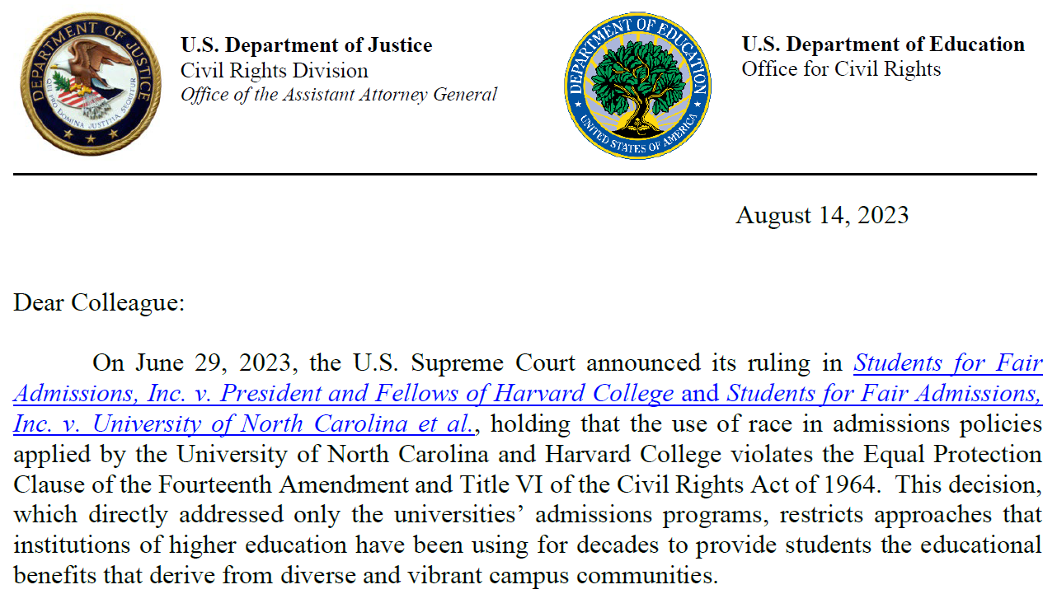
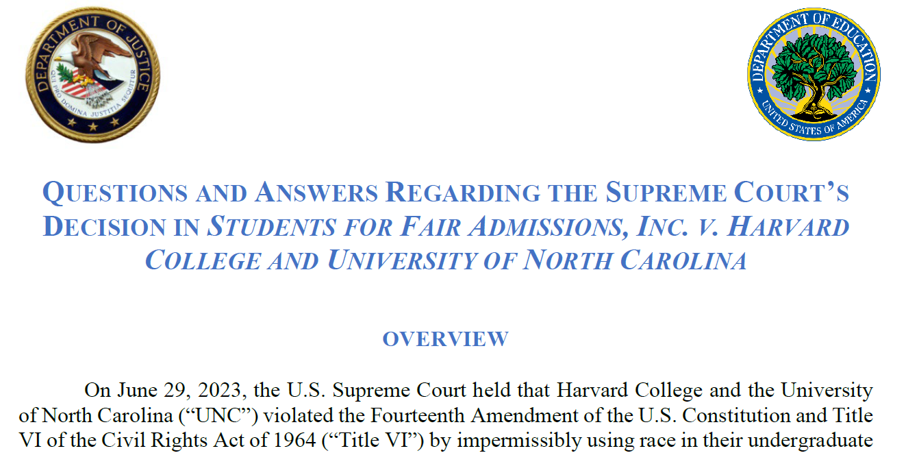

Slide 14


Holistic application review
Questions about individual background
Goals towards diversity
Pathway programs
Diverse outreach
Collect demographic data

Slide 15


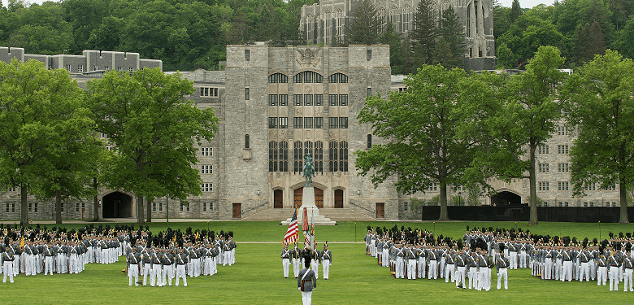


Slide 16

What’s next

Slide 17
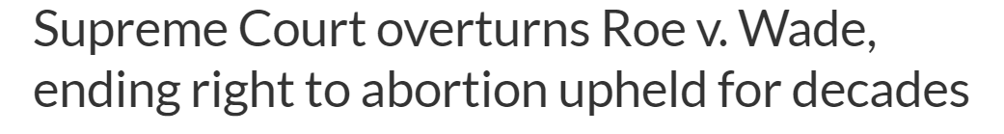
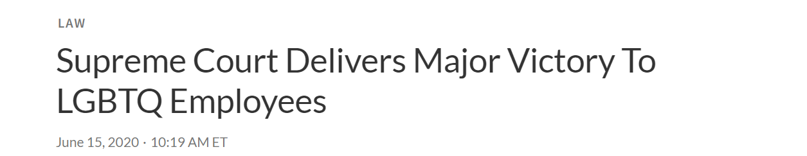
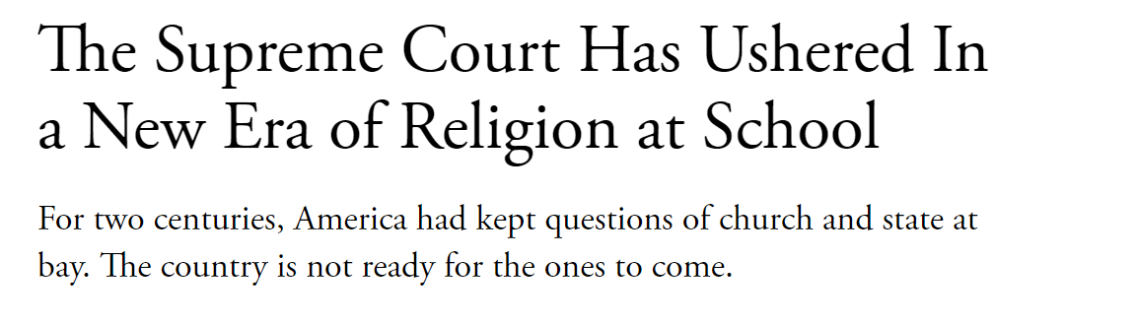
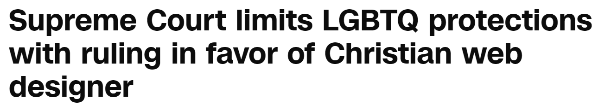
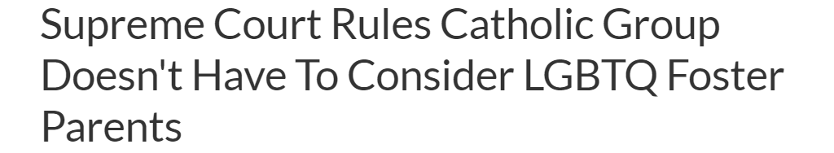

Slide 18
  “The facts in Students for Fair Admissions, Inc. concerned college admissions programs, but its reasoning is not limited to just those programs.”
  Ultima Servs. Corp. v. United States Dept. of Agriculture

Slide 19
Thompson v. Henderson, 143 S. Ct. 2412 (2023).
The “equal-treatment principle yields only when necessary to remediate ‘specific, identified instances of . . . discrimination . . . not generalized past or ongoing discrimination.”

Slide 20
Sweezy v. New Hampshire, 354 U.S. 254 (1957)
(Frankfurter, J. concurring)
It is the business of a university to provide that atmosphere which is most conducive to speculation, experiment and creation. It is an atmosphere in which there prevail ‘the four essential freedoms' of a university—to determine for itself on academic grounds who may teach, what may be taught, how it shall be taught, and who may be admitted to study.”

Slide 21
Executive Orders Affecting Higher Education

Slide 22
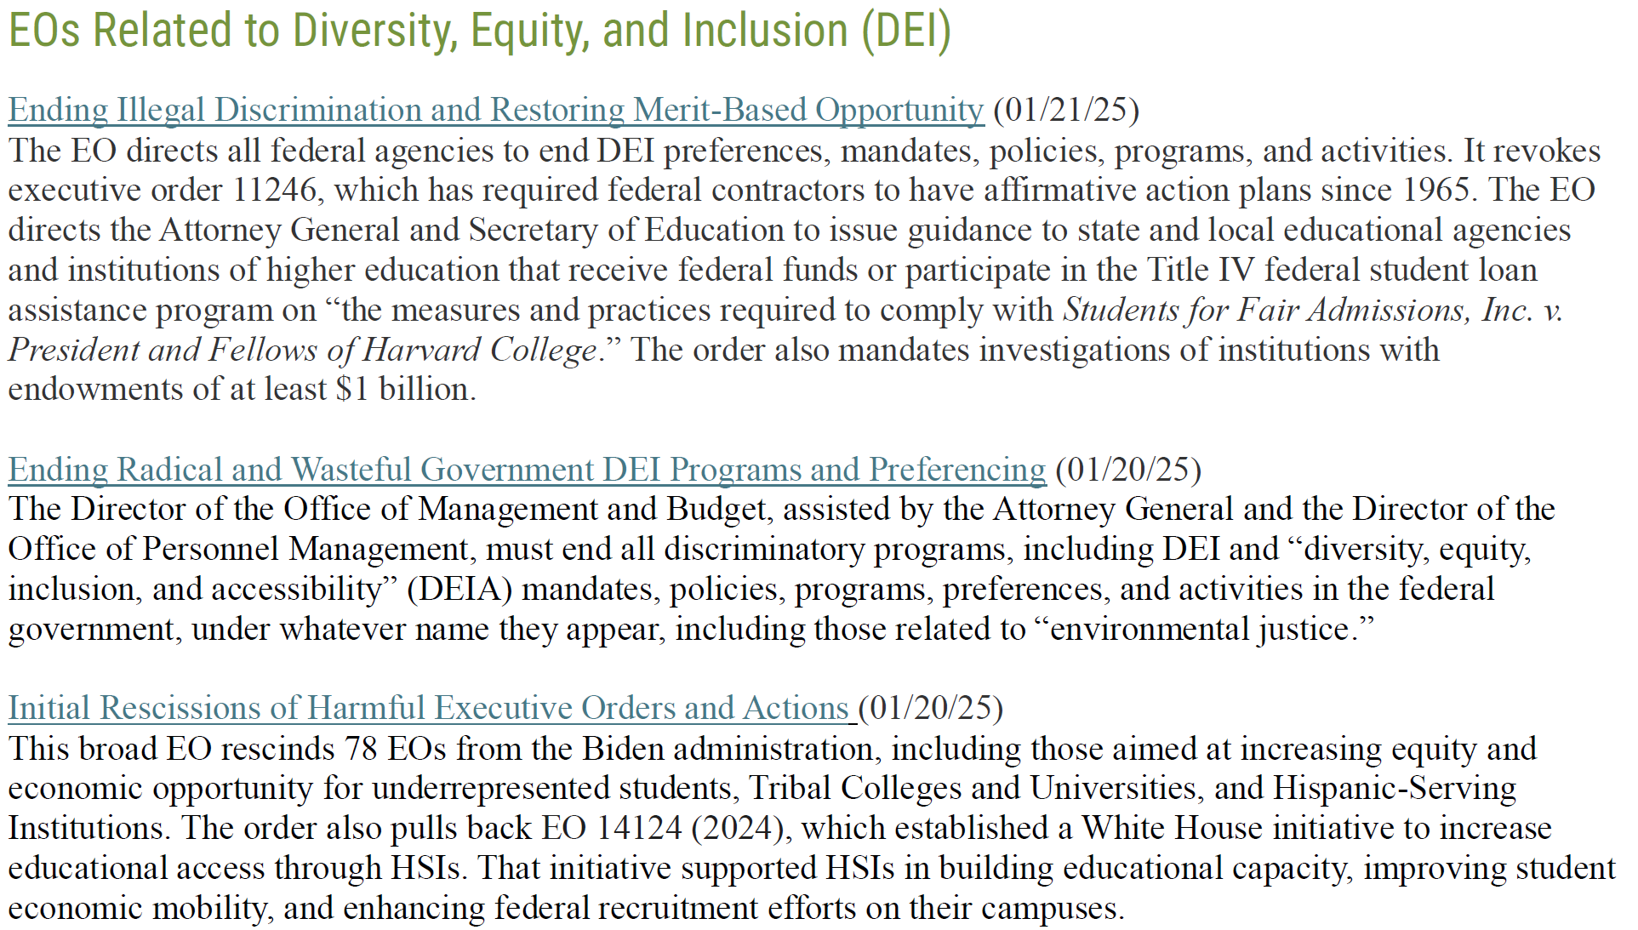

Slide 23
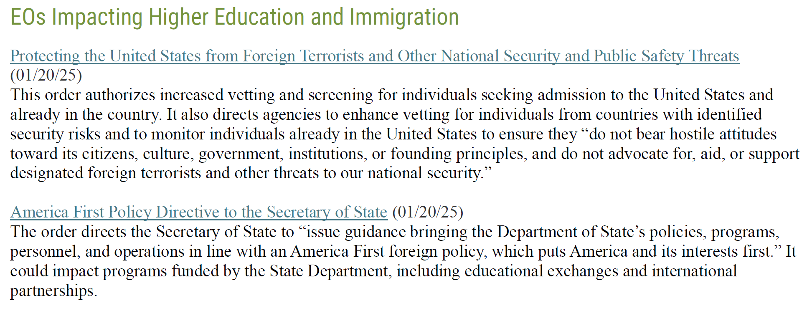
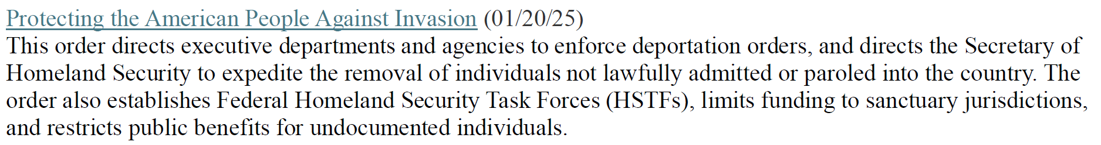

Slide 24
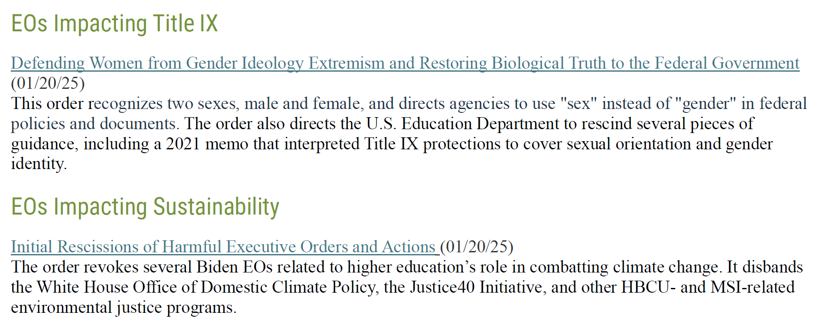
American Council on Education

Slide 25
How to Navigate the Orders
Cannot override statutory law, including state law
The executive orders address “unlawful” actions. The following remain lawful:
  Title VI
  Title VII
  Title IX
  ADA; Rehab Act
Align with “neutral” policies and carefully define your mission

Slide 26
Challenges to Executive Orders

Slide 27
National Association of Diversity Officers in
Higher Education;
American Association of University Professors;
Restaurant Opportunities Centers United;
Mayor and City Council of Baltimore, Maryland; v. Trump, et al
Filed on February 3, 2025
Challenges anti-DEI Executive Orders
Alleges:
  Violation of Spending Clause
  Due Process Violation
  Fifth Amendment Violation
  First Amendment – Free Speech
  Separation of Powers Violation
Next Steps

Slide 28




Executive Order “[d]oes not prohibit persons teaching at a Federally funded institution of higher education as part of a larger course of academic instruction from advocating for, endorsing, or promoting the unlawful employment or contracting practices prohibited by this order.”

