Slide 1
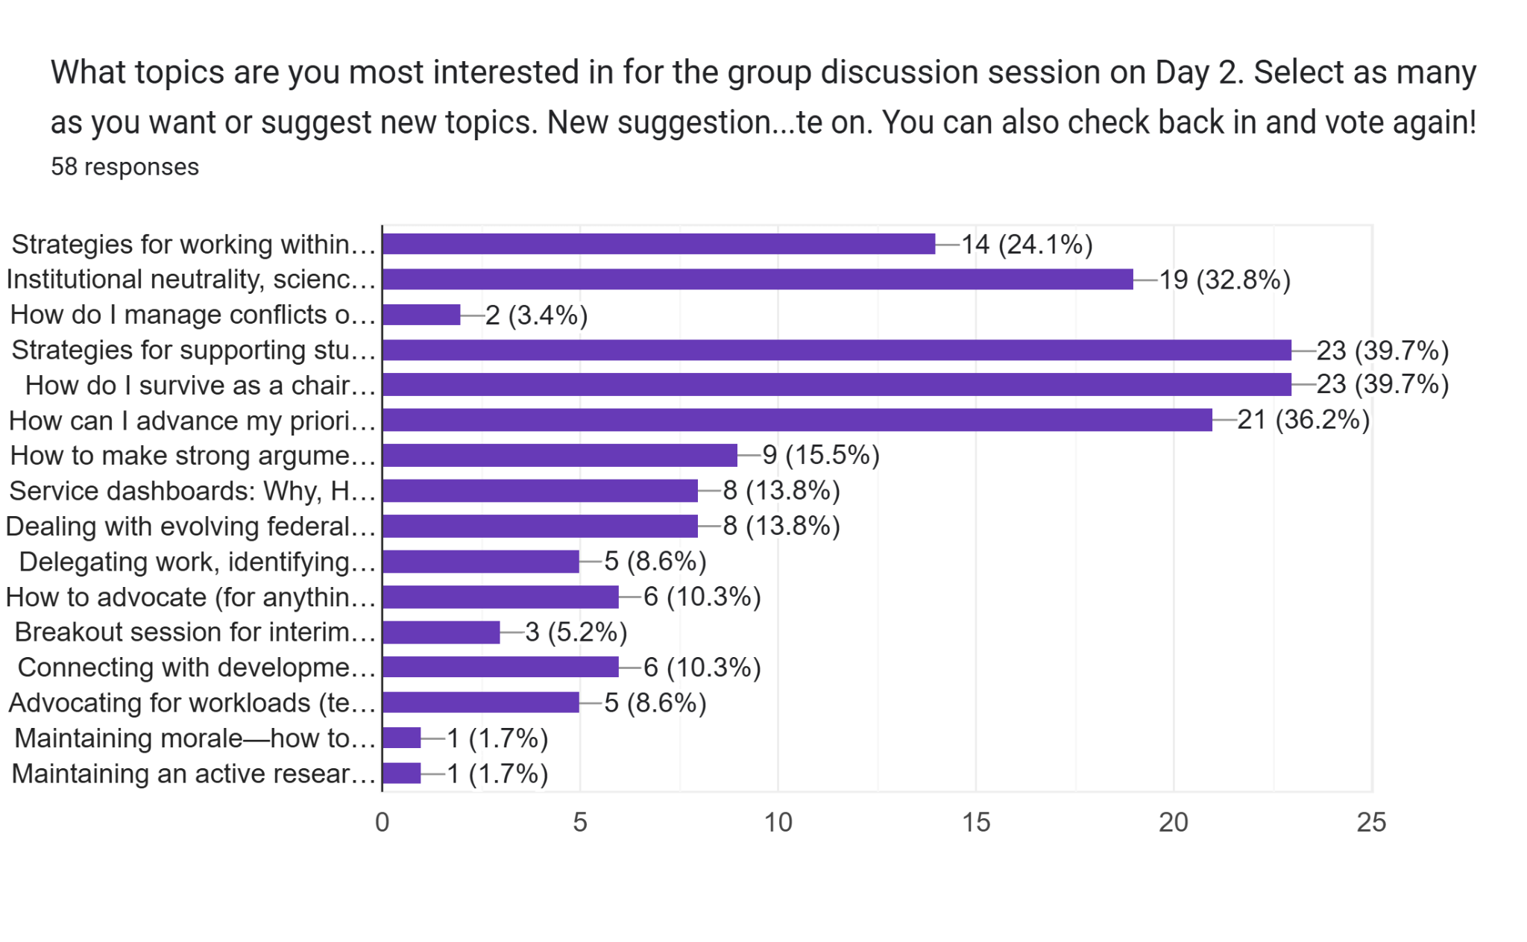
Let’s get Focused - As of 1:24pm

Slide 2

Tips for Change Makers
(yes, that means us)
Jay Smart & Mike Dougherty

Slide 3
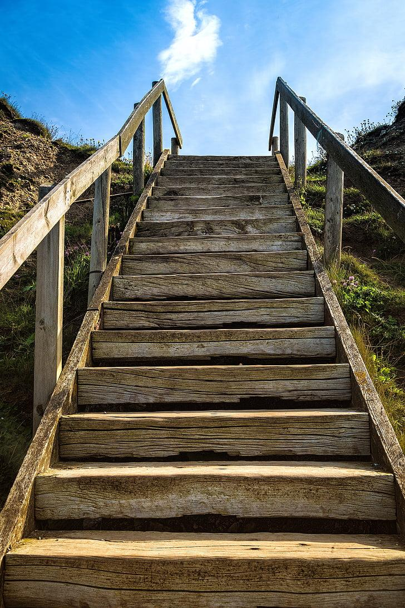
Stages of change
Before you start
Building the Change Effort.
Execution and Implementation
Sustaining and Maintaining

Slide 4
Before you Start
Build relationships
  Nothing happens on our own or without context
Create social capital - Reciprocity!
  Treating people as people
Establish a culture of trust
  Trust as chair is different from trust as colleague

Slide 5
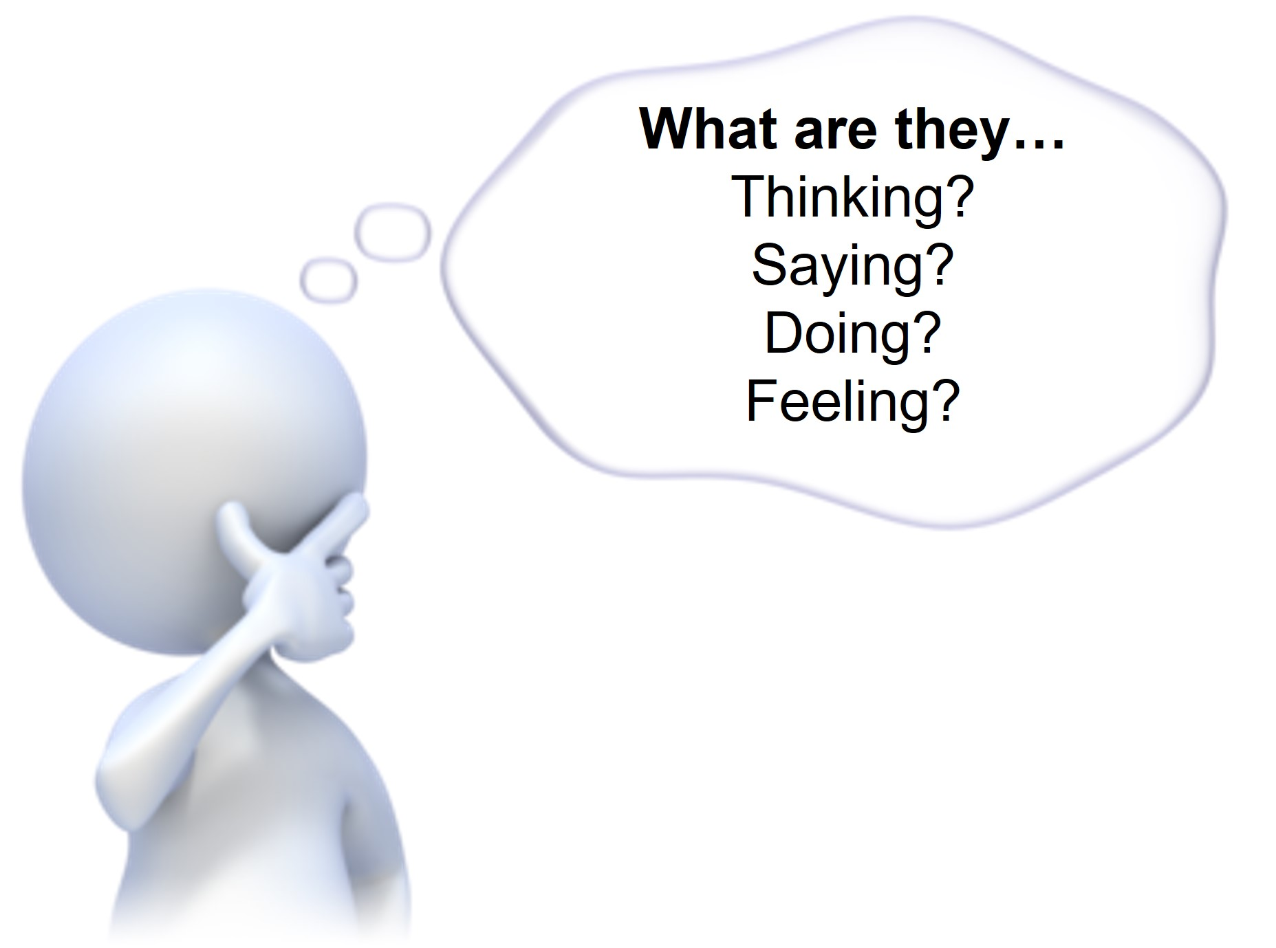
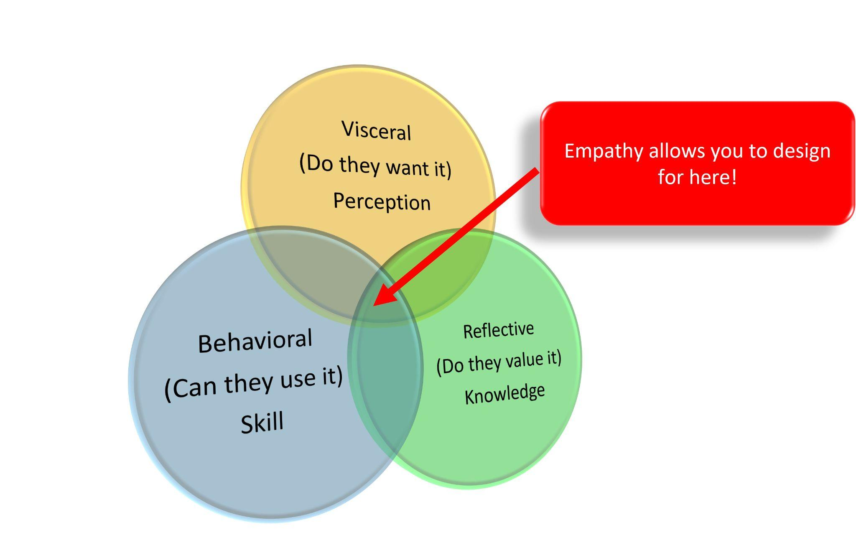
Build Social Capital
Positive relationships are your best friend
Working through (not against) human (faculty) nature: Empathy
Change happens here

Slide 6
Developing “street cred”
Socialize ideas. Key to getting folks on board
Use evidence and data. If there is none, do the work yourself
Capitalize on defaults. It’s easier to add elements to a policy than to remove them. When developing policy, work in ways that ensure they key ideas are inserted early. This relates to who you engage and when (stakeholders bullet).
Other tips
Delegate and trust.
Give faculty a license to innovate.
Link Perception (intention) and Action

Slide 7
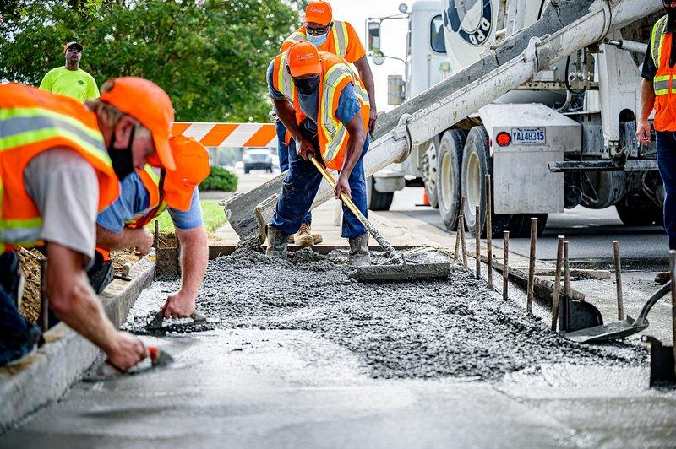
Building the Change Effort
Lay groundwork before you launch into the work
Create task forces strategically.
Know who is on board, who are easy to convince, and who will be challengers.
Focus on those in the middle.
Sensemaking: Provide context, values, potential goals
“Meet people where they are, not where you want them to be”
-create investment : Impact, Value, Connection
Work with stakeholders from the bottom up.
There’s a tendency to start with the more senior folks, but this isn’t always the right approach.

Slide 8
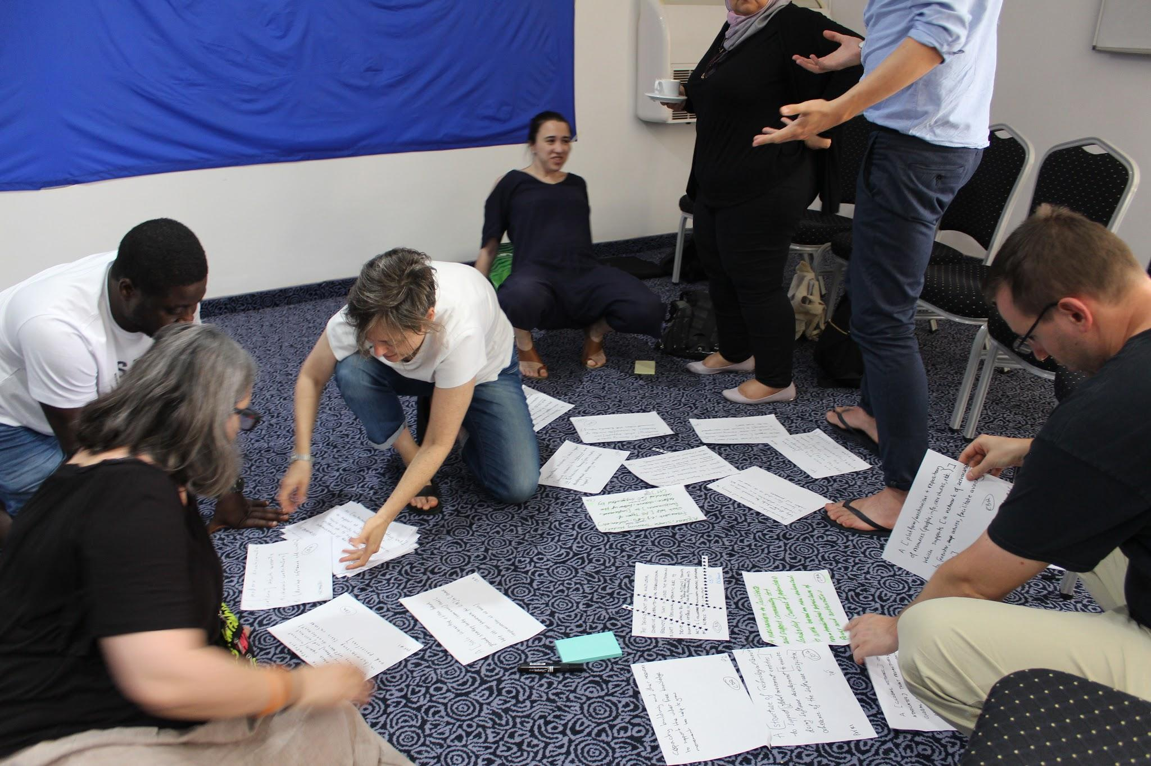
Build Tasks Forces or Working Groups Strategically
Who is already on board?
Who is easy to convince?
Who is going to be the toughest convince?
Who do the other faculty (like to) listen to?
Who’s perceived as fair?
Who has the personality to advocate?
Work with those in the middle if appropriate.

Slide 9
Leverage Compliance Techniques
Repetition (works with adults too)
Small initial commitments
Brainstorming techniques as a way to achieve “buy in”
“Model” strategies for collaboration, action
“How might we…?”: Formula: HM (actor)(action) so that (result)
Leverage defaults - easier to add than remove
How might chairs create departmental environments that reward teaching, scholarship, and service so that faculty perceive their growth and value.

Slide 10
Evidence-based decision making
Where possible, leverage data and consensus reports
Where needed, do the research yourself
Be able to show why/how things can be enhanced or discontinued
Importance of “pre-gaming” (manage what you can ahead of time - groundwork)
Foreshadowing
Repetition (see what we did there)
Setting parameters (when possible)

Slide 11
Execution and Implementation
Consensus should not the goal (usually)
We’re seeking permissions, not consensus
Don’t let perfection be the enemy of the good
Build on existing efforts
Make it relevant to what people are already doing
Make it easy on everyone else
Thought point: Most faculty are not natural persuaders or executively inclined - but collaborators and learners - this can make changemaking uncomfortable

Slide 12
Sustaining and Maintaining
Change is a process, not an endpoint
Build structures to support the change efforts
Reinforce change efforts to prevent backsliding
“System Thinking” - change has positive effects elsewhere & elsewhen
What level change are you aiming for
Change as interim chair (Surface?)
Change as chair (Deep?)
Either is meaningful (Perk?)
Thought point: Importance of ‘small goals/wins’
Visible signs of progress when possible

