Slide 1
Practical Strategies for Fostering an Inclusive Pipeline
Naz Salahuddin, Ph.D.
Director, Undergraduate Studies
Department of Psychology
University of Maryland, College Park
nsalah@umd.edu
301.405.8430

Slide 2
Overview
Factors Influencing an Inclusive Pipeline
PREP, TIPS, and Enter the PhD: Three initiatives to Build a More Inclusive Pipeline
Outcomes and Lessons Learned
Discussion: Challenges and Opportunities for Advancing Inclusive Pipelines in Diverse Educational Contexts

Slide 3
Factors Influencing an Inclusive Pipeline
Present Day Impact of Historic Exclusion
Student Success Outcomes
Participation in Important Co-Curricular Activities

Slide 4
Our Process
Climate Assessment Initiative
Fall
Survey Administration
Spring
Town Halls & Discussions
Fall
Develop & Improve Initiatives
Top Takeaway: Big differences in perceptions of access to mentoring; information
Other key points: Lack of representation in the curriculum and among faculty; exposure to bias in the classroom
#997d5a
#997d5a
#997d5a

Slide 5
Three Initiatives
Psychology Research Empowerment Program (PREP)
Transfer Integration Program for Psychology Students (TIPS)
Enter the PhD program

Slide 6
PREP Program Goals
Psychology Research Empowerment Program (PREP)
Research Training
Inclusion & Involvement
Preparation for Doctoral Study
Increase
knowledge about the research process
research self-efficacy
participation in research
Develop
mentoring relationships with faculty and staff members in psychology
close relationships with other psychology students
active involvement in the department and field
Increase knowledge about
doctoral programs in psychology
application and selection process for doctoral students
specific steps that will make for strong applicants to doctoral programs

Slide 7
PREP Program Structure
Additional Expectations
Involvement in PSYC
Commitment to your own professional development and that of your PREP peers
Spring 2025
PREP for Psychology
(1 Credit Course)
Apply to research labs
Spring 2026
PREP for Graduate School
(1 credit course)
Involvement in Labs
PREP Values
Honesty and Integrity
Character and Community
Respect for Self and Others
Fall 2025
PREP for Research
(1 Credit Course)
Apply for McNair and Summer Research
Fall 2026
PREP for Next Steps
(1 credit course)
Involvement in Labs

Slide 8
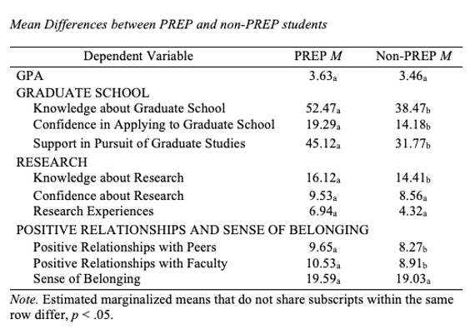
Outcomes
O’Brien, K. M., Trovato, K. J., Harris, M. G., Serrano, S. D., Ngum, S. E., Hill, E. M., & Salahuddin, N. M. (2022)

Slide 9
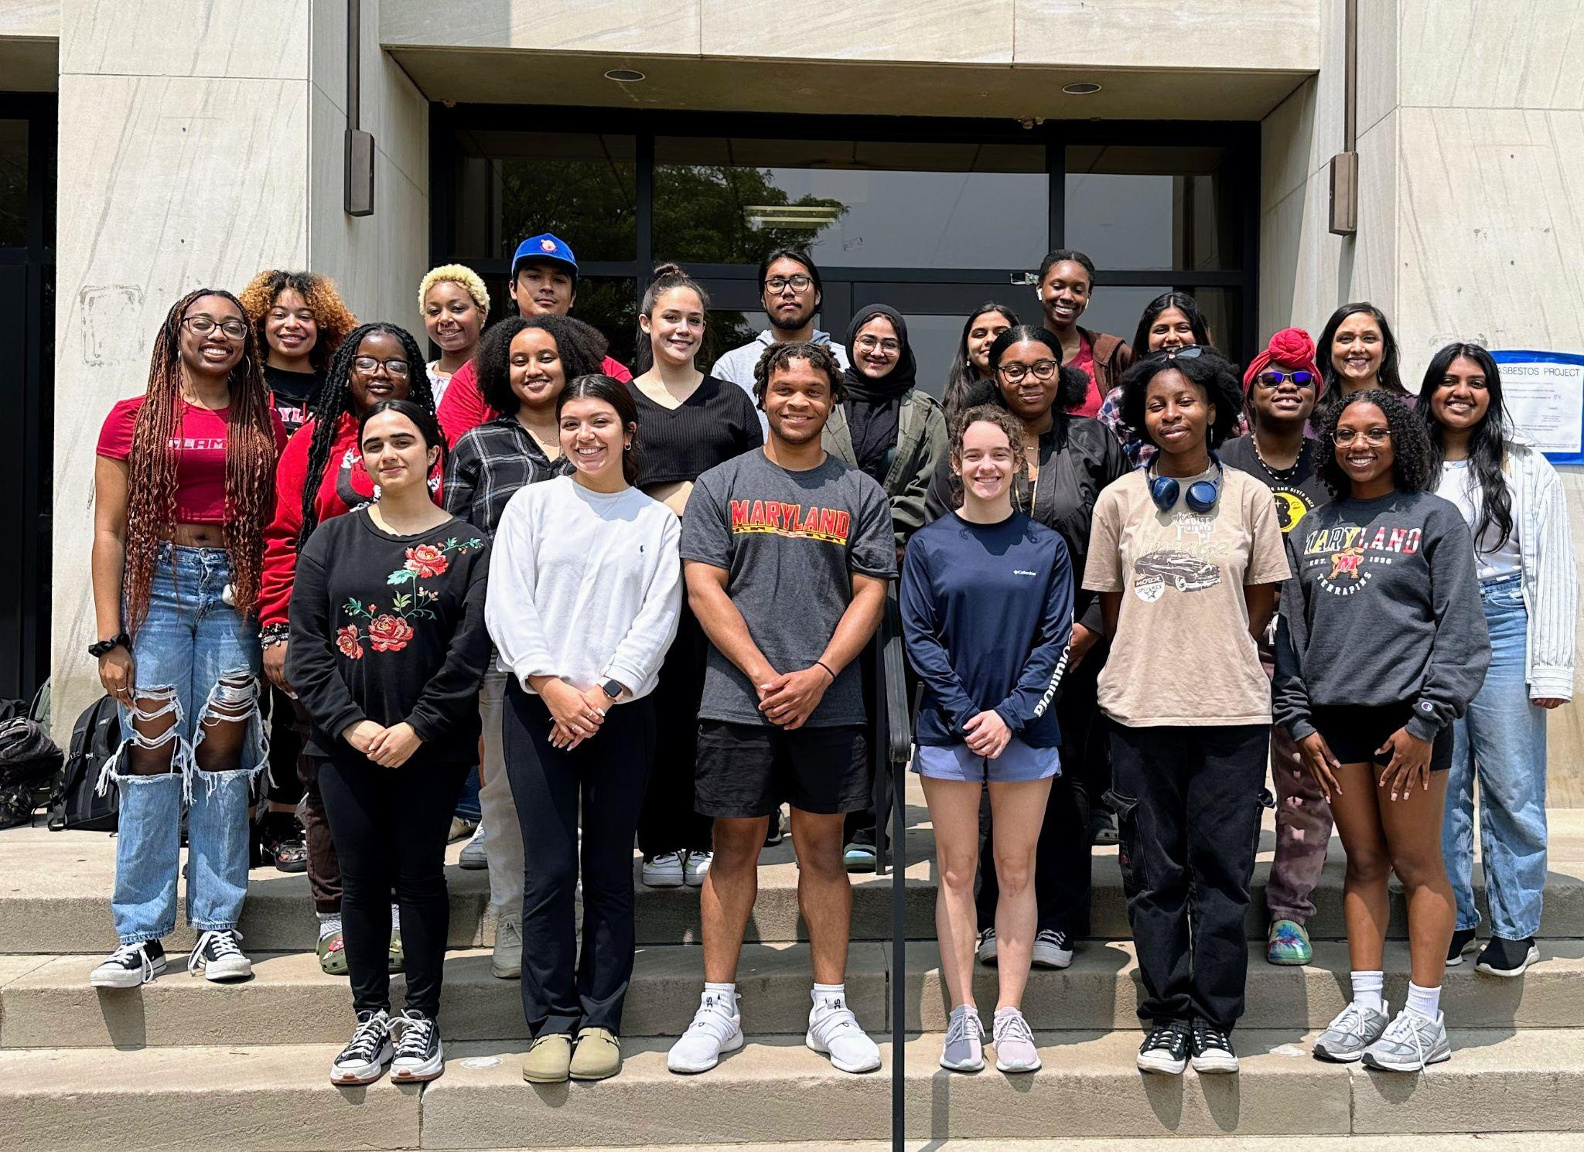
PREP History
It made me feel like I had chance to follow my dream
First cohort started in 2017
3 cohorts graduated
46% are enrolled in graduate school, with 15% in doctoral level programs
12% are completing post-bacs and currently applying to graduate study
Grad school + post-bac = 58%
Fourth cohort finished courses, but not yet graduated.
Fifth cohort began January 2025.
The PREP Program helped me to learn the graduate school process, gave me a community, and a space to feel comfortable learning in.

Slide 10
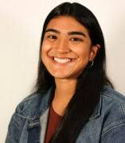
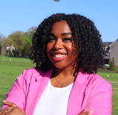
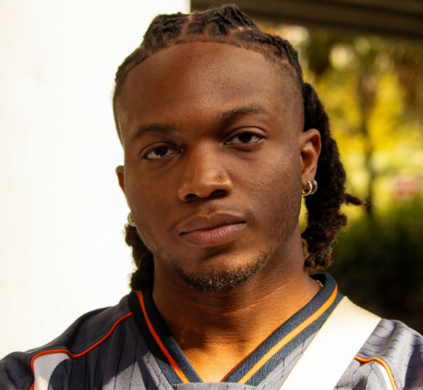
PREP Alums: Where are They Now?
Stacey Cabrera
Whitney Clarke
Michael Spooner
Doctoral Student
Community & Applied Developmental
University of Illinois - Chicago
Doctoral Student
Counseling Psychology
University of Illinois, Urbana-Champagne
Doctoral Student
Industrial/Organizational Psychology
Florida International University

Slide 11
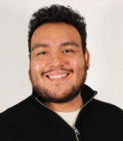
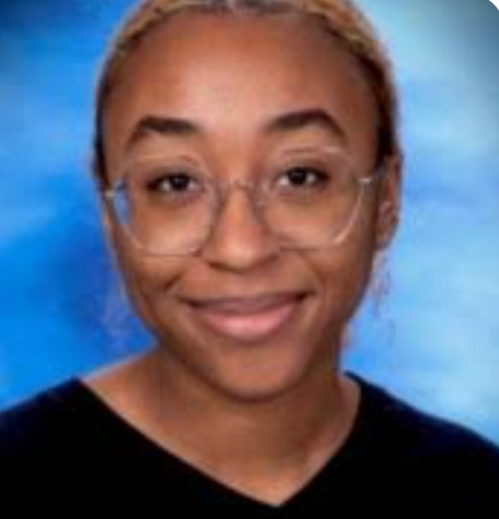
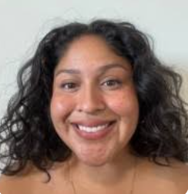
PREP Alums: Where are They Now?
Carlos Melendez
Dominique Austin
Silvia Serrano
Doctoral Student
Community & Applied Developmental
University of Illinois - Chicago
Doctoral Student
Criminal Justice
City University of New York
Doctoral Student
Counseling Psychology
University of Auburn

Slide 12

Transfer Integration Program for Psychology Students (TIPS)
Purpose:
Build community among cohorts of transfer students
Dedicated academic advisor
Monthly lunch & learns with cohort and advisor on thoughtfully timed topics, share opportunities and expand network

Slide 13

Transfer Integration Program for Psychology Students
Restart: Climate survey data; informal interviews of transfer students; transfer student leader
Community building within major may not be top priority
Often little free time for lunch & learns
Targeted and timely emails are more effective
Dedicated academic advisor - Individual advisor meetings upon request
Those who are interested in more involvement are encouraged to join PREP

Slide 14
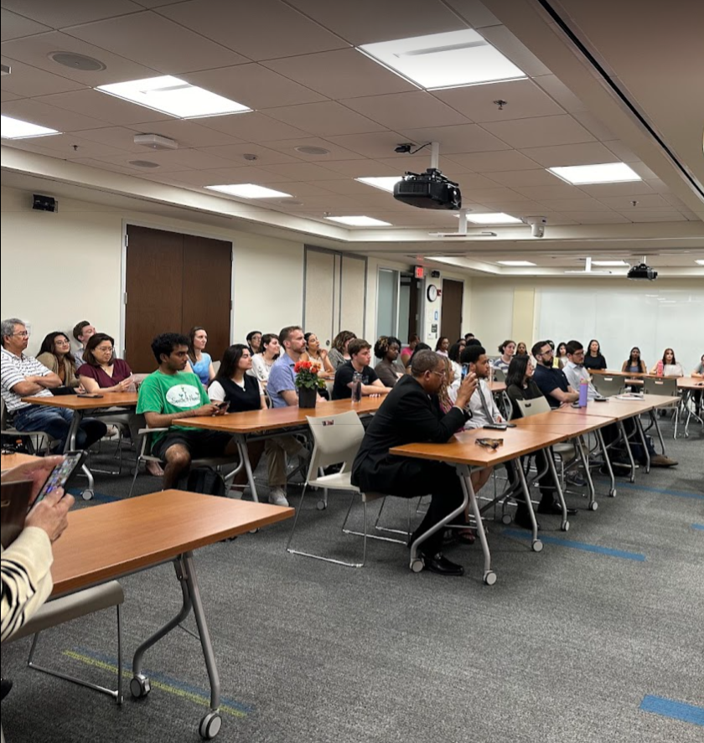
EnTER the PhD Workshop
Annual full day workshop designed to demystify doctoral programs in psychology
First and second year undergraduates are welcome to apply
First generation, historically excluded, and students from low- income households are especially encouraged

Slide 15





Enter the PhD – Participants & Agenda
2019 - 14 students from UMD only
2024 - 47 students from 5 universities
  Broad departmental participation
    Approx 15 faculty & 5 doctoral students
Agenda
Grad School Information Session
Faculty Research Blitz
Practitioner Panel
Grad Student Roundtable & Lunch
Lab Crawl & SRI Information Session
Faculty Roundtables
Mentoring Workshop

Slide 16
Enter the PhD – Pre & Post Survey
Survey Question | Before (out of 7) | After (out of 7)
I am interested in pursuing a Ph.D. in Psychology | 5.87 | 5.98
I feel confident that I know what it takes to put together a strong application for Ph.D. programs in Psychology. | 3.37 | 5.94
I have a good understanding of what the UMD Psychology Department Ph.D. programs offer. | 3.53 | 5.78
I valued the openness and transparency of the panel…
… the knowledge I gained about what a Ph.D. entails. I thought that it was just more school …
..hearing more about what the faculty are looking for and the steps I should be taking to be ready for later…

Slide 17
Resources & Lessons Learned
People
Time & Rewards
Funding
Most important!
Small effort by many faculty and graduate students makes a huge difference.
Build some responsibilities into committee work – broadens the investment
Strong collaborations with students is VIP
Leadership presence and involvement
How can efforts be considered ‘on load’ or part of a person’s core duties? (Undergraduate Director? Asst Chair?)
“Prime time” (facutly meeting) allotted to presenting the initiatives and engaging faculty
How can the department reward and show value for the work (awards/recognition?)
On load teaching
Core duties for UG Director
Fundraising efforts for scholarships, graduate school applications, conference and interview travel
Departmental support
Teaching grants

Slide 18
Creating an Inclusive Pipeline in a Changing Landscape
Define Goals
Collaborate
Identify factors influencing a diverse pipeline in your context
What are your constraints and barriers?
What action is possible and how?
Which resources can be leveraged?
Involve students, student groups, and student leaders at each stage
Engage faculty
Recruitment & Roll Out
Assessment and Revision
First generation student organizations/events
Transfer student organizations/events
Affinity groups
Engage student leaders in roll out
How is success defined?
Assess, revise, assess

Slide 19
Discussion: Creating an Inclusive Pipeline in a Changing Landscape
1. What do you see as the most challenging barriers to implementing initiatives to foster inclusion of historically excluded groups at your own institutions?
2. What strategies could be employed to address those barriers?
3. What programs are you implementing at your own institutions?
4. What is one feasible step that you can now take toward fostering greater inclusion?

Slide 20
Thank You

Slide 21


