Slide 1


February 8, 2025
Psychological Sciences
in the
Second Trump
Administration
COGDOP
Juliane Baron​
Executive Director​
Federation of Associations in Behavioral & Brain Sciences​

Slide 2
Presentation Outline​
Day 18​
Federal Agencies​
119th Congress ​
FABBS Priorities​
What Can We Do?​
Juliane Baron​
Executive Director​
Federation of Associations in Behavioral & Brain Sciences​

Slide 3
Things to Remember​
The chaos is by design
Many of the troubling EO and directives are unconstitutional or conflict with legislative direction
This is a democracy with strong institutions
Juliane Baron​
Executive Director​
Federation of Associations in Behavioral & Brain Sciences​

Slide 4
Shared Goals​
Advance educational opportunities and outcomes​
Support health and prevent illness​
Maximize value of taxpayer dollars​
Drive a vibrant economy​
To compete inter-nationally​
Juliane Baron​
Executive Director​
Federation of Associations in Behavioral & Brain Sciences​

Slide 5
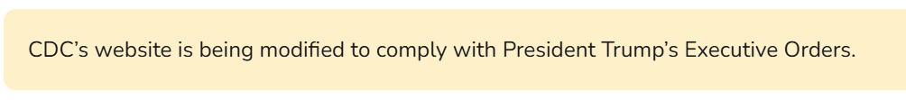
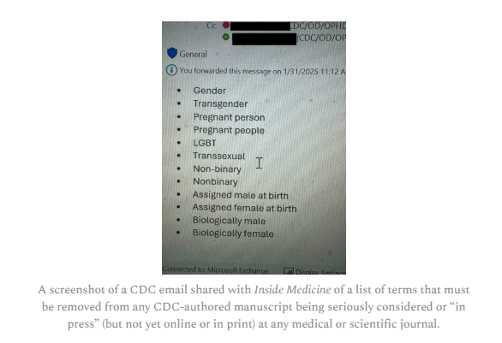
CDC
  Many websites have disappeared or been stripped down, providing skeletal information, including resources on HIV, STIs, contraception, and gender-affirming care.
  Taxpayer-funded data sets from federal websites have also been removed
  Scientific papers ordered to remove gender-related terms
Screenshot from Inside Medicine
Juliane Baron​
Executive Director​
Federation of Associations in Behavioral & Brain Sciences​

Slide 6

USAID
  President Trump and Elon Musk have been working to shutter USAID
  Employees have been placed on administrative leave
.
  Overseas missions have been halted
  The legality of these moves is in question, given that Congress created the agency.
Juliane Baron​
Executive Director​
Federation of Associations in Behavioral & Brain Sciences​

Slide 7
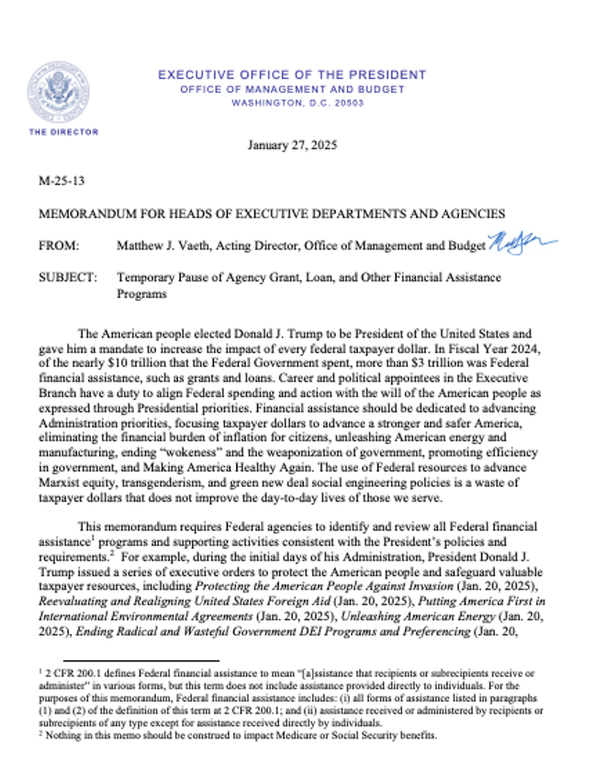


Office of Management and Budget (OMB) Directive ​
​
Juliane Baron​
Executive Director​
Federation of Associations in Behavioral & Brain Sciences​

Slide 8

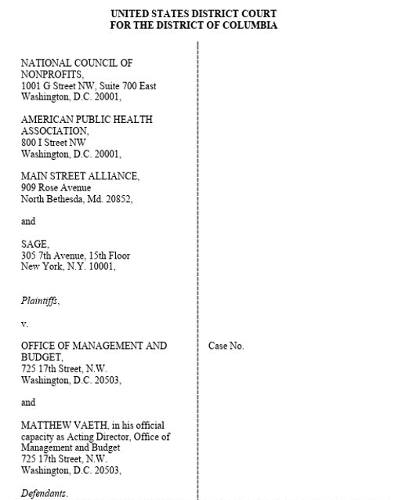
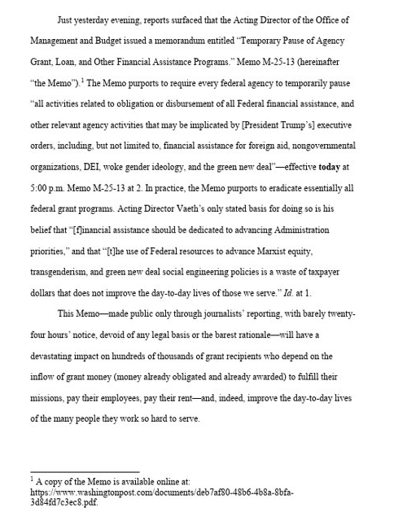
Office of Management and Budget (OMB)
Directive – Judge Issues Stay​
Juliane Baron​
Executive Director​
Federation of Associations in Behavioral & Brain Sciences​

Slide 9
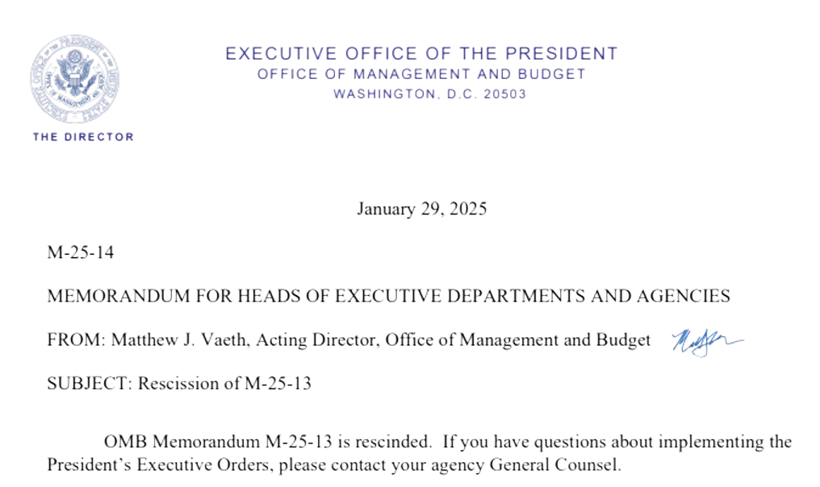
Office of Management and Budget (OMB) Directive - Rescinded
Juliane Baron​
Executive Director​
Federation of Associations in Behavioral & Brain Sciences​

Slide 10
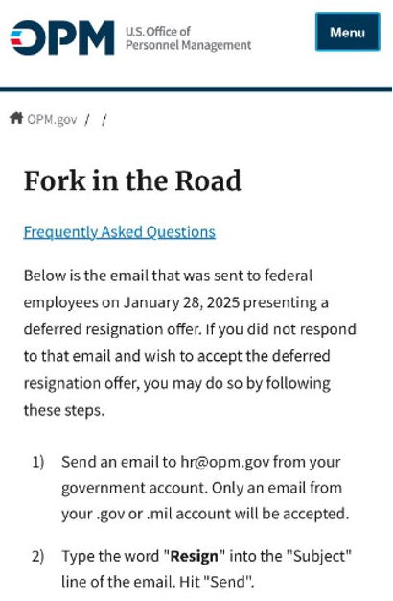

Fork in the Road Email​
​
The Office of Personnel Management sent an email to 2 million federal worker offering them a chance to preemptively resign, implying additional and unspecified Trump administration efforts to shrink government.
Juliane Baron​
Executive Director​
Federation of Associations in Behavioral & Brain Sciences​

Slide 11
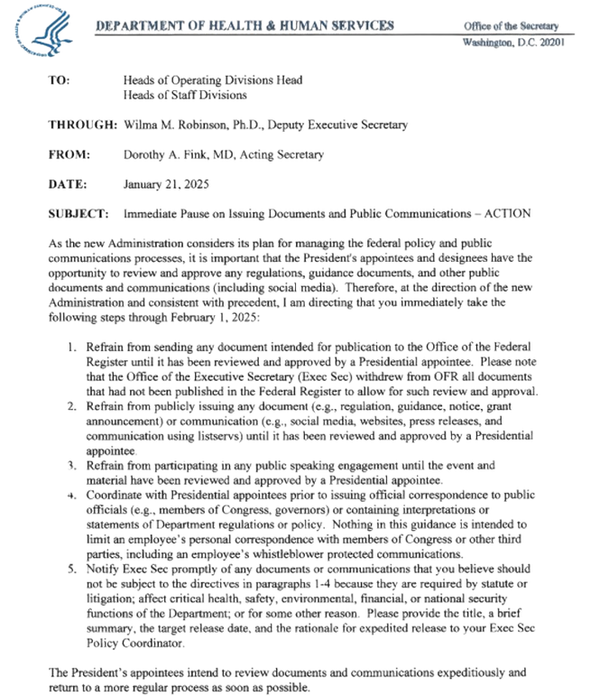
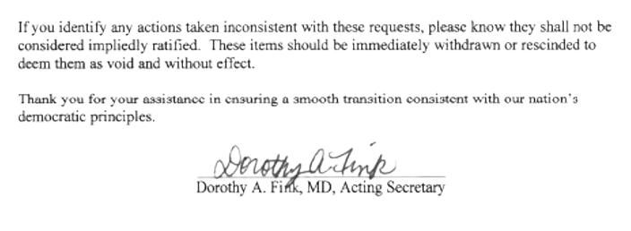
Health and Human Services (HHS) Directive​
​
Juliane Baron​
Executive Director​
Federation of Associations in Behavioral & Brain Sciences​

Slide 12

Executive Orders​
DEI -Equity and Civil Rights​
Immigration​
Management of the Federal Government and Workforce​
Repealing Biden EOs​
Reenact Trump EOs Repealed by Biden​
List of Presidential Actions
List of Executive Orders
Juliane Baron​
Executive Director​
Federation of Associations in Behavioral & Brain Sciences​

Slide 13
Key Federal Science and Technology Positions
President's Council of Advisors on Science and Technology (PCAST) ​
Office of Management and Budget (OMB) ​
Office of Science and Technology Policy (OSTP)​
Director
Michael Kratsios​
Executive Director Lynne Parker
Director
Russ Vought​
Juliane Baron​
Executive Director​
Federation of Associations in Behavioral & Brain Sciences​

Slide 14
Federal Agencies​
National Institutes of Health (NIH)​
National Science Foundation (NSF)​
Institute of Education Sciences (IES)​
Advanced Research Projects Agency for Health (ARPA-H)​
Juliane Baron​
Executive Director​
Federation of Associations in Behavioral & Brain Sciences​

Slide 15



National Institutes of Health
Jay Bhattacharya, MD, PhD, Stanford​
Acting Director – Matthew Memoli​
NIH is within the Health and Human Services Department – Robert F. Kennedy, Jr. has been nominated for Secretary. ​
Federation of Associations in Behavioral & Brain Sciences​

Slide 16

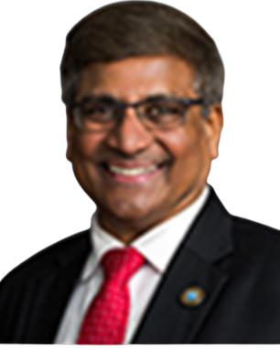
National Science Foundation ​
National Science Board - Members serve six year terms, so some protection from the political winds.​
  Alondra Nelson, Institute for Advanced Studies​
  Joan Ferrini-Mundy, University of Maine​
  Victor McCrary, University of District of Columbia​
  Wanda Ward, University of Illinois​
  Willie May, Morgan State University, AAAS President​
Dr. Panchanathan is serving
a six year term, until June 2026.
He is eligible to be reappointed.​
Federation of Associations in Behavioral & Brain Sciences​

Slide 17
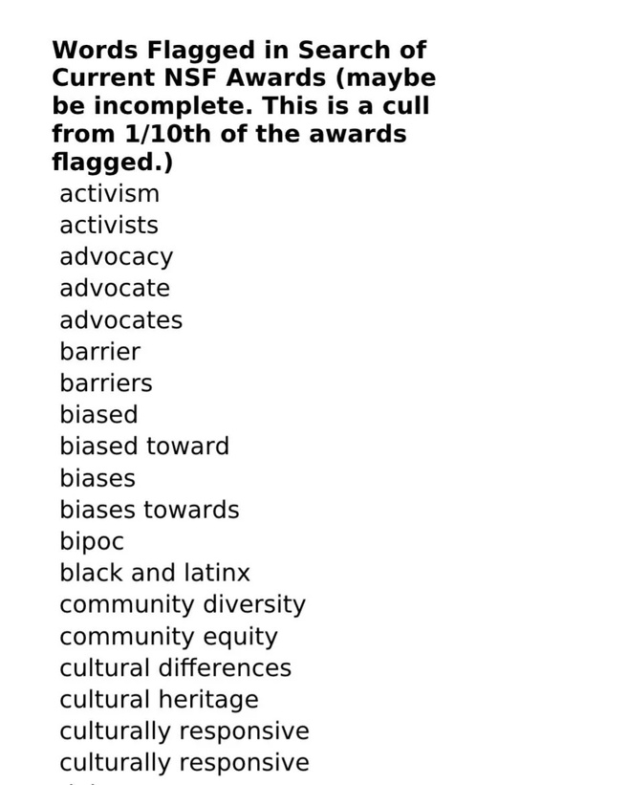
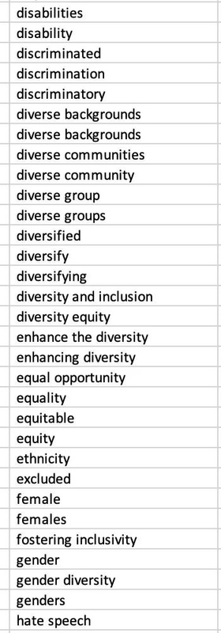
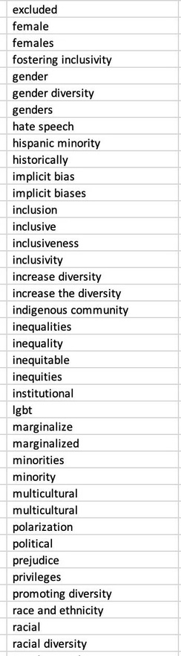
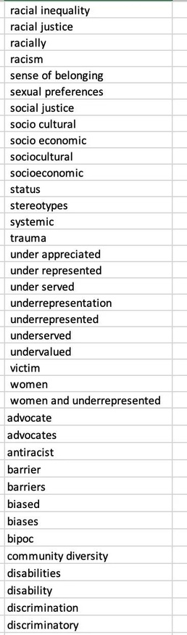
National Science Foundation
Juliane Baron​
Executive Director​
Federation of Associations in Behavioral & Brain Sciences​

Slide 18
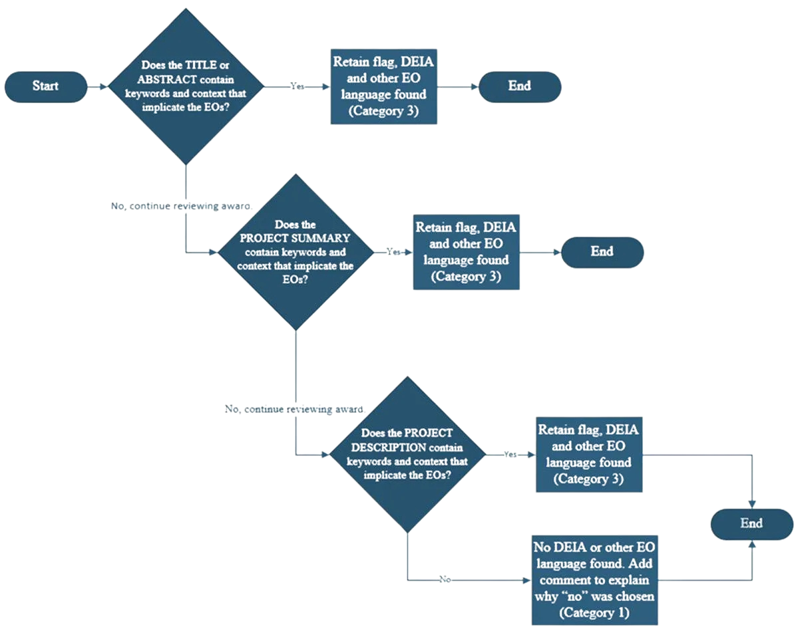
National Science Foundation
Juliane Baron​
Executive Director​
Federation of Associations in Behavioral & Brain Sciences​

Slide 19
House Science Committee
February 05, 2025
Letters to Science Agency Leaders Regarding President Trump's Reckless Executive Orders
Letter to NSF Director Sethuraman Panchanathan
February 04, 2025
Ranking Members Huffman, Lofgren Sound the Alarm on Musk’s Invasion at Key Science Agency
National Science Foundation
Juliane Baron​
Executive Director​
Federation of Associations in Behavioral & Brain Sciences​

Slide 20

Institute of Education Sciences
• IES sits within the U.S. Department of Education. Project 2025 recommends moving the statistical office to the Census Bureau and research centers to NSF.
• President Biden nominated Adam Gamoran, PhD, as Director in September 2024 but he did not receive confirmation during the past administration.
• National Board of Education Sciences has full membership however has lacked an executive director.
Juliane Baron​
Executive Director​
Federation of Associations in Behavioral & Brain Sciences​
Federation of Associations in Behavioral & Brain Sciences​

Slide 21

Advanced Research Projects for Health (ARPA-H)
• ARPA-H is a research funding agency that supports transformative biomedical and health breakthroughs –ranging from the molecular to the societal – to provide health solutions for all.
• Created in March 2022, ARPA-H received $1.5 billion in fiscal year 2024.
• Likely to be a target to undue a Biden legacy.
Juliane Baron​
Executive Director​
Federation of Associations in Behavioral & Brain Sciences​

Slide 22

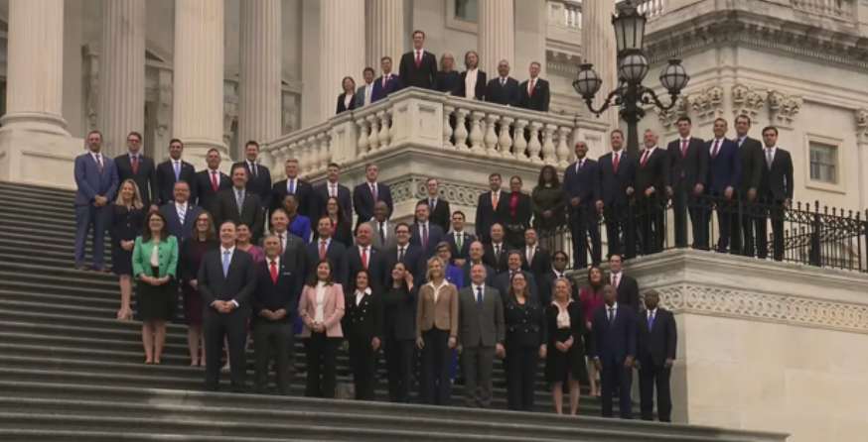
January 30, 2025​
​
119th Congress​​
​
Juliane Baron​
Executive Director​
Federation of Associations in Behavioral & Brain Sciences​

Slide 23
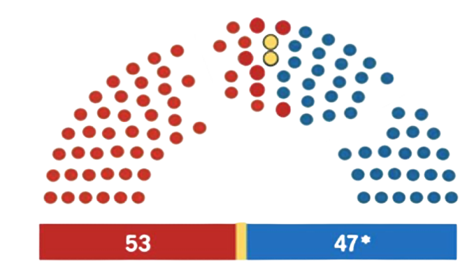
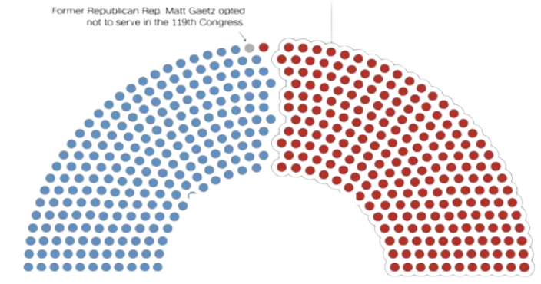
​
119th Congress​​
​
Senate
  100 members of the Senate (Six-year term)​
  Freshman Senators: 6 Democrat and 6 Republican​
  119th is composed of 47 Democrats (includes 2 Independents
who caucus with Democrats) and 53 Republicans​
House​
  435 members of the House of Representatives ​(Two-year term)​
  Freshman Representatives: 33 Democrat and ​30 Republican​
  215 Democrats and 220 Republicans (217) ​
​
Images from FASEB Town Hall
Juliane Baron​
Executive Director​
Federation of Associations in Behavioral & Brain Sciences​

Slide 24
Senate Committee Leadership​
  Appropriations – Susan Collins (R-ME) and Patty Murray (D-WA)​
    Commerce, Justice, Science, and Related Agencies Subcommittee – Jerry Moran (R-KS) and Jeanne Shaheen (D-NH)​
    Labor, Health and Human Services, Education, and Related Agencies Subcommittee – Shelley Moore Capito (R-WV) and Tammy Baldwin (D-WI)​
  Commerce, Science, and Transportation – Ted Cruz (R-TX) and Maria Cantwell (D-WA)​
  Health, Education, Labor and Pensions – Bill Cassidy (R-LA) and Bernie Sanders (I-VT)​
Juliane Baron​
Executive Director​
Federation of Associations in Behavioral & Brain Sciences​

Slide 25
House Committee Leadership​
  Appropriations – Tom Cole (R-OK) and Rosa DeLauro (D-CT)​
    Commerce, Justice, Science – Hal Rogers (R-KY) and Grace Meng (D-NY)​
    Labor, Health, and Human Services, Education – Robert Aderholt (R-AL) and Rosa DeLauro (D-CT) ​
  Science, Space, and Technology ​- Brian Babin (R-TX) and Zoe Lofgren (D-CA)​
  Energy and Commerce Committee (Health) - Brett Guthrie (R-KY) and Anna Eshoo (D-CA)​
  Education and the Workforce - Tim Walberg (R-MI) and Bobby Scott (D-VA)​
Juliane Baron​
Executive Director​
Federation of Associations in Behavioral & Brain Sciences​

Slide 26


NIH Reauthorization​
Senator Cassidy Releases White Paper on Modernization of NIH​
FABBS Responds to House Committee’s NIH
Juliane Baron​
Executive Director​
Federation of Associations in Behavioral & Brain Sciences​

Slide 27

Attacks on NSF​
  Senator Joni Ernst’s (R-IA) letter to DOGE​
  Senator Ted Cruz’s (R-TX) report on NSF funding and DEI​
Juliane Baron​
Executive Director​
Federation of Associations in Behavioral & Brain Sciences​

Slide 28
On the Agenda for Congress this Year​
NIH
Reauthorization​
IES
Reauthorization​
Higher Education Act​
Topical – AI, Climate
Juliane Baron​
Executive Director​
Federation of Associations in Behavioral & Brain Sciences​

Slide 29
Appropriations & Authorization ​
Appropriations
Appropriations Legislation ​Provides
spending for the agencies and programs previously authorized ​ Congress is not required to provide appropriations for an authorized discretionary spending program ​ Congress may provide appropriations for programs or agencies whose authorization has lapsed​.
Authorization​
​
Establishes, continues, or modifies federal agencies or programs .​​
​
Often includes funding targets for an agency over a given time period​.​
Juliane Baron​
Executive Director​
Federation of Associations in Behavioral & Brain Sciences​

Slide 30

APPROPRIATIONS​
Timeline
FABBS Response​
FABBS works with coalitions to determine the community ‘ask’ the number that they will be encouraging Congress to appropriate for federal agencies supporting behavioral and brain sciences.​
President Submits Budget​
  Working with coalitions, FABBS signs letters to leadership and Budget committees advocating for strong allocations to subcommittees.​
  Meet with committee staff to make the budget request.​
Congress determines allocation for 12 appropriations subcommittees 302bs​
Members of Congress determine their funding priorities and have a variety of ways for communicating their priorities to Appropriators​
  Member requests - FABBS submits Member requests to 5 - 7 Congressional offices, asking MOCs to include key funding agencies in their priorities​
  Dear colleague letters - As co-chair of the Coalition for National Science Funding, FABBS help draft and circulates letters, seeking signatures. ​
  Report language
  Submit testimony​
  Working with Congressional offices on questions for witnesses​
Congress determines allocation for 12 appropriations subcommittees 302bs​

Slide 31
APPROPRIATIONS​
Timeline
FABBS Response​
House and Senate Appropriations committees release budget proposals​
FABBS, together with coalitions, respond to proposed budgets.​
FABBS communicates with committee staff and personal offices.​
House and Senate committees vote on budgets​
FABBS works with coalitions to determine the community ‘ask’ the number that they will be encouraging Congress to appropriate for federal agencies supporting behavioral and brain sciences.​
Full House and Senate vote on budgets​
Office of Management and Budget begins developing budget for FY 2026​
FABBS meets with OMB analyst to encourage strong funding for our disciplines.​
President releases Research and Development Priorities for FY 2026​
FABBS underscores importance of behavioral and brain sciences to support Administration priorities.​
FABBS works with coalitions to support higher levels of funding for agencies of interest.
House and Senate conference on FY 25 budget​

Slide 32
Finding a Path Forward​
What Can We Do?​
Juliane Baron​
Executive Director​
Federation of Associations in Behavioral & Brain Sciences​

Slide 33
Understanding the Current Political Environment​​
Political context is overpowering traditional advocacy tools​
We are having the wrong conversations
So much noise and confusion​
Juliane Baron​
Executive Director​
Federation of Associations in Behavioral & Brain Sciences​

Slide 34
Current FABBS Priorities​
Providing reliable information and focusing on big picture and what could move the needle
Providing reliable information and context, focusing on big picture and what could move the needle
Encouraging Republican Senate Offices to provide oversight​
Supporting our members to engage and use constituent voices​
Keeping the health and science community together​
Identify new allies – even strange bedfellows​
Juliane Baron​
Executive Director​
Federation of Associations in Behavioral & Brain Sciences​

Slide 35
Reach Out to Your Elected Officials​
FABBS can help:​
Share
policy updates ​
Background and contact information ​
Talking points​
Identify
key audiences​
We are developing resources​
Juliane Baron​
Executive Director​
Federation of Associations in Behavioral & Brain Sciences​

Slide 36
Questions for Chairs
Providing reliable information and focusing on big picture and what could move the needle
What are you telling their trainees and students?
What are you hearing from your university leadership?
How are
you
supporting
early career scholars
What advice are you giving to DEI scholars?
Could chairs share information/ pool information or resources?
Juliane Baron​
Executive Director​
Federation of Associations in Behavioral & Brain Sciences​

Slide 37







FABBS Opportunites
Internships
  Student Internship Positions
  What internships does FABBS offer?
Positions for fall, winter, spring and
  summer.
  What experience do interns gain at FABBS?
  Would you like to be part of our internship?
  Gain experience in science policy, advocacy, and communications as they collaborate closely with our staff to support operations of the FABBS Washington, DC office
Juliane Baron​
Executive Director​
Federation of Associations in Behavioral & Brain Sciences​

Slide 38

FABBS Opportunites
Student Awards
  What are the FABBS Doctoral Dissertation Research Excellence Awards and Undergraduate Research Excellence Awards?
  The FABBS Doctoral Dissertation Research Excellence Awards and Undergraduate Research Excellence Awards honor student investigators who have conducted research of superior quality and with broader societal impact.
  For more information.
Juliane Baron​
Executive Director​
Federation of Associations in Behavioral & Brain Sciences​
Juliane Baron​
Executive Director​
Federation of Associations in Behavioral & Brain Sciences​

Slide 39




Get in Touch
Thank
You
Contact us to get more info
info@fabbs.org
1200 New York Ave. NW
Suite 459
Washington, D.C. 20005
fabbs.org

